Slide 1


Pre-PMI IT Work Stream
Capgemini‘s RFS Response

Slide 2



OUR FOCUS IS ON DAY 1 PREPARATION, SECURING BUSINESS CONTINUITY, PLANNING SYNERGY TARGETS AND DETAILLING FIRST “100 DAYS”
SOLUTION PRESENTATION
Letter
of intent
Contract
signing
Closing of deal
“Day-1” – Q1 2025
Quick wins delivered Convergence planning
Pre-signing
Day 1 Preparation
First ‘100 days’
Integration execution
  Assessment & Analysis
  Conduct Detailed Due Diligence
  Evaluate Industrial and IT value
  Iterate on deal conditions
  Integration Preparation
  Plan to secure business continuity
  Design convergence plan (Applications, Infrastructure and IT Operating Model)
  Refine synergy targets and TSA
  Detailed plan First « 100 days »
  Convergence planning
  Stabilize business continuity
  Deliver & track synergies
  quick wins
  Monitor & track TSA
  Consolidate convergence plan
  Convergence Implementation
  Implement convergence plan
  Build One Company
  Maximise merger’s benefits
Secure business continuity through seamless run of IT operations at day 1 (people, tools, process, operating model) and anticipation of key risks on the cybersecurity side
Deliver synergies’ quick wins on the IT cost side (e.g. on central IT functions mutualization, contract massification), as well as on the revenues side – which may be IT-dependent
Define the IT evolution roadmap required to support the vision and speed on IT and network services convergence (OSS, BSS, ERP and Office IT)
Build a medium to long term vision & trajectory for IT convergence & transformation, to develop & build a harmonized IT foundation and operating model for the new entity such as:
  Best-in-class IT stack identification
  ERP migration
  OSS modernisation
  Data Center migration/consolidation
Assess dependencies with other workstreams throughout the steps above
Must have
IN SCOPE OF THIS PROPOSAL
OUT OF SCOPE OF THIS PROPOSAL
Capgemini 2024. All rights reserved |
2

Slide 3







OVERALL SCOPE & APPROACH - PROJECT'S STREAMS
SOLUTION PRESENTATION
Stream 1: Governance
Consolidate information to prepare day 1 and define 100 days plan. Risk mgmt. and interlock with IMO and other workstreams
Stream 2: IT Synergy plan and TSA disentanglement
Consolidate synergies plan accordingly with TSA update, validate assumptions & feasibility while continuously liaising with Business
Assessment
Design
Roadmap
Stream 3: Operating Model (Intermediate and Target)
Define a Product oriented Operating Model and related intermediate scenarios to ensure smooth transition and standardization
Stream 4: Application Domain (incl. Architecture, BSS, OSS, ERP, Office IT)
Define Application Landscape convergence and target state. Ensure a unified application stack and seamless migration experience
Stream 5: Data & AI
Define Data & AI framework, in terms of process and technology, to be used at Day 1 and be further refined and strengthen
Stream 6: Cloud, Infrastructure & Cyber Security
Define an integrated infrastructure architecture and related migration strategy. Define Cloud Strategy roadmap based on multi-cloud Telco best practices
Stream 7: Sourcing & Contract Management
Define Service migration strategy to ensure harmonized IT investments
Capgemini 2024. All rights reserved |
3

Slide 4
HIGH-LEVEL PROJECT PLAN
SOLUTION PRESENTATION
Plan to be syncronised with SwissCom / FW constraints
June
July
August
September
October
November
December
Stream 1:
Governance
Risk & Escalation mgmt., interlock with IMO and other workstreams
Day-1 prerequisites & Preparation
Day-100 Prerequisites & Prep of Integration Exec
Stream 2:
IT Synergy plan and TSA
Synergy Sync
Synergy Plan Analysis & Review
Agreement on Final Synergy Plan
Current TSA Analysis & Gap Analysis (on small & medium)
TSA Disentanglement Plan Definition
Stream 3:
Operating Model
Assessment (both companies Operating model & methodologies)
Iterative Design, syncing with other stream’s inputs, for Digital TOM (Intermediate and Target State)
Roadmap Definition
Stream 4:
IT Application Domain
AS IS Discovery & Bus Drivers Gathering
Side by Side VF/FW application portfolio review
ERP Dis-entanglement High Level Strategy
IT Strategy (Transition and End State Architecture Roadmap)
High Level Integration Plan
Adaptations
Stream 5:
Data & AI
Mandatory Reporting Preparation & Initial Synergy Delivery
Data & AI Enterprise Enablement
Data Integration Planning
Stream 6:
Cloud, Infra & Cyber Security
Cloud & Infra Assessment
Cloud & Infra Design & Roadmap Definition
Cyber Security Assessment
Cyber Security Design & Roadmap Definition
Adaptations
Office IT Assessment
Office IT Design & Roadmap Definition
Stream 7:
Sourcing & Contracts
Analysis of the As-Is Contracts
Iterative Design (syncing with other stream’s inputs)
RFS Deliverables
#1 – IT readiness requirements for the first 2 years after closing
#5 – IT Strategy (Detailed Design)
#7 – Infra migration plan
#2 – Side-by-side review of VF / FW application portfolio
#8 – Sourcing Strategy
#3 – ERP disentanglement high level strategy
#6 – Initial IT HL
Integration Plan
#4 – Risk mitigations actions
#9 – TOM & Org.
#X: RFS Deliverables
4
Legend:
We suggest to postpone the deadline (if possible)
Capgemini 2024. All rights reserved |

Slide 5
STREAM 1 | INTERLOCKING IT GOVERNANCE & STREAMS WITH TRANSVERSAL IMO
SOLUTION PRESENTATION
The IT workstream’s Governance body will interface with the central IMO in terms of:
Alignment on strategic shifts impacting IT and other Workstreams (Day-1 timelines, constraints, etc.)
Alignment on strategic decisions cross-workstreams (eg: Business priorities, TSA plan, Synergy plan)
Track, analyze and address workstreams interdependencies, share risks & ensure overall coordination & Day-1 securitization
Set-up an Orchestration Office to:
Review and align IT project portfolio (eg: kill, review scope or confirm ongoing projects) to avoid conflicting and duplicated agenda
Ensure effective Program Mgt., Risk mgt. and Synergies tracking and realization
Manage pace of speed between the several streams to assure dependencies and milestones
Set-up an Integration Design Authority which will be responsible of : ​
Defining, documenting and validating the convergence of each system (Apps & Infra)​
Ensuring overall IT coherence at global / local level​
Securing a detailed inventory of global / local assets.
Integration Management Office (IMO)
Central SteerCo
Sponsors
Central OpCo
Commercial WS
Functional Workstreams
People
Closing & SPA Mgmt
B2C
B2B
WHS
Network
IT
G&A
CM & Org
SPA Mgmt
Reg
IT Swisscom / FASTWEB
IT INTEGRATION PREPARATION
IT VODAFONE
CIO
Stream 1 : IT Governance
CIO
IT Teams
IT Teams
Orchestration Office
Integration Design Authority
Transfo Projects
Stream 2: IT Synergy plan and TSA
Transfo Projects
BaU
Stream 3: App Domain
BaU
Stream 4: Cloud, Infrastructure & Cyber
Stream 5: Operating Model
Stream 6: Data & AI
Stream 7: Sourcing & Contract Management
NEED TO FOCUS ON EFFORTS ON THE INITIAL STEPS TO SECURE
DAY-1 PREPARATION & COORDINATE IT STREAMS WITH IMO
Capgemini 2024. All rights reserved |

Slide 6
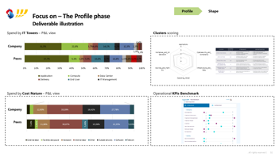
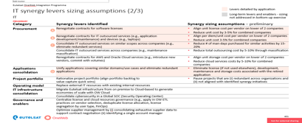
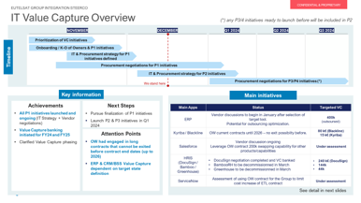
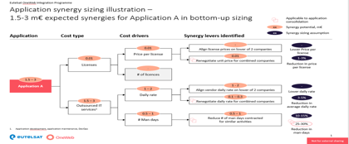
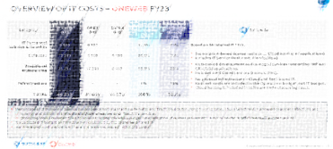
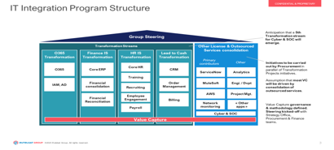
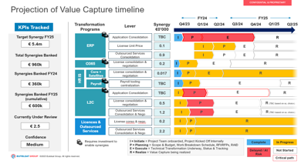

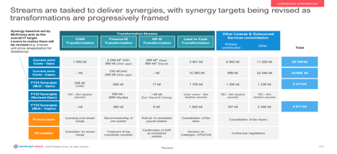
SOLUTION PRESENTATION
STREAM 2A | IT SYNERGY PLAN
In order to ensure the synergies identified in the M&A phase, it’s important to launch a detailed synergies analysis and validation to build a synergy plan that take into consideration dependencies, IT development costs, TSA disentanglement and timeline in an iterative approach.
Costs – AS-IS Analysis
Synergies review
Synergies Monitoring
The first step is to refresh our IT Costs Telco market benchmarks with the latest figures & the relevant streams focus.
We start by reviewing synergies assumptions before analyzing costs & synergies drivers.
Once buckets are defined, we need to review the synergies roadmap & planning, anticipating risks & interdependencies.
Then, we compare the benchmark with costs mapped for both companies & define our first version of the IT costs baseline.
Then, we define synergy buckets, regrouped by streams and refine the sizing based on reviewed IT costs baseline.
Before Day-1 the last step is to prepare the upcoming synergies monitoring through a tailor-made tracking tool.
Capgemini 2024. All rights reserved |
6

Slide 7
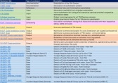





SOLUTION PRESENTATION
STREAM 2B | TSA MANAGEMENT & DISENTANGLEMENT
TSA - Management
TSA Exit - Do’s & Don’t
TSA Exit - Strategy
We developed a TSA Tracker to optimize the entire lifecycle management before preparing the disentanglement which can be adapted to your context.
Our extensive experience in TSA Management allowed use to identify best practices on how to prepare the exit
TSA Maximum duration & Notice periods
Based on each TSA criticality, TSA monitoring team in partnership with Domain's leads / project owners needs to follow TSA exit maximum date & anticipate notice periods and Exit conditions
Do’s
1
Invoicing
1
The structure of the contract (by IT Services or by site, etc) drives the exit plan
All precedent conditions to exit any service are the checklist to manage: source, KM, Open Incidents and Problems, etc
Close monitoring of costs and effectiveness of services save a lot of money: TSA costs is not a fixed fee to be paid by the buyer
No TSA exit on-time without a strong carve-out/in plan
Every month, invoices will need to be tracked, and thus need to be entered for each month of the year. It allows to track/reduce financial risks & optimize costs.
Cost analysis (part of synergy analysis)
The TSA monitoring team in partnership with Domain’s leads/project owners should ensure that TSA Exit will be profitable on a long-term perspective. They will need to validate projects’ Build/Run costs & compare it to TSA costs to understand if an early termination is favorable.
2
Governance
2
Every month, the committees / meeting dates and their realization must be updated to ensure a proper TSA steering.
Don’t
The bundling of TSA are never the technical optimum by Apps, Servers & FTEs to transfer
Whereas transparency is the rule in 90% of the TSA, the Seller never justify enough the costs of TSA; and the Buyer always consider it as too expensive for IT services provided.
It’s quickly a source of dispute / tensions
Small remaining pieces prevent to exit completely from one whole IT service letting significant costs to pay as the Seller cannot decommission it fully
TSA Exit checklist
Domain's leads / project owners should validate the TSA exit checklist to ensure that all the requirements are covered (data transferred, build , licensing, support, knowledge transfer, infra, cyber , etc.).
Dashboard
3
3
Every month, any services requiring termination attention must be addressed individually & referenced.
The goal of having a solid TSA exit plan/strategy is to protect the value the transaction seeks to create and prevent unnecessary long-term reliance on another entity, save capital and free up team members to focus on strategic activities that support the growth thesis.
Capgemini 2024. All rights reserved |
7

Slide 8
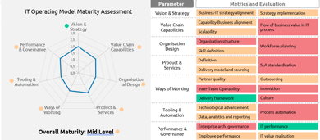
SOLUTION PRESENTATION
STREAM 3 | IT OM: CAPGEMINI FRAMEWORK TOWARDS AN AGILE TOM
The crucial part of the IT Operating Model will be not only to assess both companies based on Capgemini’s parameters framework, but also to highlight the key differences and design principles to be taken into consideration for the IT Target Operating Model definition
Framework
Dimensions
Our convictions for defining the TOM
Vision & Strategy | Alignment of strategy and goals between the Business and IT. Assess IT portfolio to review initiatives priority
IT Capabilities & Processes | Process and capability mapping to drive the Target Operating model design. Focus on accountabilities and grey areas to be tackled and addressed (eg: Demand mgmt., SW development,…). The underpinning concept will be a Product oriented organization to ensure customer centricity, business alignment, innovation and fast time to market
Organisation Design | Description of how the IT organisation is structured, with the right sizing and skills. Leverage on E2E and Cross-functional team principle with fit-for-purpose role definition to achieve Organizational Agility, avoiding silos and fragmentation
Product & Services | Identification of key offerings to define IT Product & Services (jointly with Business), establishing appropriate management mechanisms, KPIs and target to drive product & services roadmap and evolution.
Ways of Working | Analysis of different ways of working (eg: waterfall, hybrid agile, full agile, bi-modal, SAFe), where they are applicable, how they can scale while ensuring delivery effectiveness. This include skills and competences dimensions and Culture
Tooling & Automation | Adoption of digital tools and automation opportunities leveraging GenAI across IT delivery and operations like continuous integration and deployment, analytics and process automation (eg: GenAI, cognitive, OCR,…)
Performance & Governance | Establishment of lean and fit-for-purpose IT governance mechanisms (eg: IT Strategy update and alignment, Financial Mgmt, Lean Portfolio Mgmt) and effective Performance Mgmt capability
2
1
7
Process & capabilities
3
Performance &
Governance
Organisation Design
2
Vision
&
Strategy
1
6
4
3
Tooling & Automation
Product & Services
5
4
Ways of
Working
5
Example of As-Is operating model assessment
6
7
Capgemini 2024. All rights reserved |
8

Slide 9

STREAM 3 | IT OPERATING MODEL: ORGANIZATIONAL AGILITY JOURNEY
SOLUTION PRESENTATION
Our proposed approach
1
2
3
4
5
Assess both companies operating models (way of working, agile maturity, product portfolios,…) and value stream mapping on selected digital products
Define TOM based on a tailored xScale Digital Factory model and a reviewed / optimized Delivery Framework for “Standard Delivery”
Gap Analysis, roadmap definition, prioritization and quick win identification (eg: B2B/B2C products to be created / migrated into Digital Factory 1.0)
Set-up xScale Digital Factory 1.0 with People, Processes, Tools and understand Business involvement
Scale-up the Digital Factory, through new value streams identification to build a proper IT Factory (eg: LPM, LACE,…)
Digital Factory 1.0
Digital Factory 2.0
IT Factory
Our Convictions:
Demand Mgmt
Demand
Demand
Start building the Digital Factory by merging both companies’ Digital applications (ie: BSS, Data, AI)
Design Authority for design technical accelerators and architectural patterns to scale, validate design and ensure IT convergence
Portfolio Mgmt: for unified and prioritized backlog and alignment/orchestration between Digital Factory, Standard Delivery and Test/ITSM capabilities
Portfolio Mgmt
Portfolio
Portfolio
Standard Delivery
Design authority
Design authority
IT Factory
Design authority
Digital Factory 2.0
Standard Delivery
…
Digital Factory 1.0
Standard Delivery
Test, ITSM
(eg: Incident & Release Mgmt)
Test, ITSM
(eg: Incident & Release Mgmt)
Test, ITSM
(eg: Incident & Release Mgmt)
Capgemini 2024. All rights reserved |
9

Slide 10

STREAM 4 | APPLICATION DOMAIN | OVERALL APPROACH
SOLUTION PRESENTATION
Assessment and Discovery
Strategic Planning
Gap Analysis, Decisioning & Blueprinting
Create a comprehensive inventory of all existing BSS/OSS applications, Infrastructure, Products and of Vodafone and FastWeb.
Requirement Capture through interviewing stakeholders and leveraging on assets
Gather information to assess Digital Maturity of FastWeb and Vodafone using TMF Digital maturity model.
Understand the business and technical key KPIs for FastWeb and Vodafone
Understand Total Cost of ownership of existing landscape for both the organizations
Gather all Financial Constraints and targets to be achieved from target OSS/ BSS architecture.
Understand the IT architecture principles, security posture and strategies for the merged entity
Take roadmap of existing Transformation programs
Create the IT Strategy, aligned to the Strategic vision of NewCo and will include:
•Vision
•Roadmap
•Define guiding principles
•Financial evaluation
•Short, Medium and Long term objectives
•Security and Governance
•High level target state
•Personnel
Set future Product strategy and architecture in collaboration with product owners of both Fastweb and Vodafone.
ERP Disentanglement Strategy through the analysis of the current ERP environment and the creation of a ERP dedicated to the merged entity within 24 months
Comparative analysis of existing IT components taking strategic requirements into account.It will include benchmarking and identification of strengths & weaknesses of each option for various ODA domains (ClearSight tool for assessment)
Infrastructure Migration Strategy and Plan to support the target state architecture
Integration Strategy and Plan will include a strategy on merging of Digital engagement channels to build One company experience.
Target architecture Blueprint along with Transition states and product roadmap.
Customer Migration Approach will be developed as part of the Transition Plan
Deliverables
IT Readiness Requirements
IT Strategy
Application Analysis
Architecture Blueprint
Integration Plan
Infrastructure Migration Plan
Why Capgemini
  Follow a data-driven approach and fact-based analysis across IT and business/IT relationships and priorities
  Leveraging Capgemini’s own clearSight tool & expertise to support accelerate the objectivation & of the analysis based on facts
  Address both buyer and seller by integrating / leveraging the different teams in strict ‘clean team’ set-up with all confidentiality obligations attached
  Pragmatic & collaborative ONE TEAM approach across the buyer, seller and Capgemini to ensure all parties are involved & heard
  Set up Exco-level governance level with bi-weekly steering committees to validate progress and make key guiding decisions
  Stakeholders involved at CxO level, including CEO direct report, CIO, CMO and top directors as main client counterparts
Capgemini 2024. All rights reserved |
10

Slide 11
STREAM 4A | INTEGRATE ENTERPRISE ARCHITECTURE APPROACH
SOLUTION PRESENTATION
1. Business objectives
Business Vision and Strategy: Align on a unified business vision and growth strategy for the merged entity.
Market Operations: Address overlap in consumer, enterprise, and wholesale markets for mobile and wireline offerings.
Impact on Offerings: Determine how new product offerings affect strategic architecture.
Prioritization: Decide on delivery and transition priorities for each line of business.
3. Existing technology Landscape
Create Inventory: List all BSS/OSS applications of Vodafone and FastWeb.
KPI Analysis: Identify key business KPIs to find strengths and weaknesses.
TCO and Scalability: Assess Total Cost of Ownership, scalability, flexibility, and future-readiness of current systems.
Cost and Target Constraints: Gather cost constraints and targets for the new OSS/BSS architecture.
Strategic Goals Impact: Evaluate the impact of major programs.
Digital Maturity and Technical Debt: Assess digital maturity, technical debt, and flexibility of existing applications.
Detailed IT Assessment: Use tools like clearSight, interviews, surveys, and deep dives to evaluate IT operations.
Business Objectives
Architecture and Security Principles
Existing technology Landscape
Industry and Technology Best Practice
End State Architecture
1
5
2
2. Architecture Principles
It is essential that the architecture principles and security posture for the merged entity is agreed.
Architecture principles – underlying general rules and guidelines for the use and deployment of all IT resources and assets across the enterprise.
Reflect a level of consensus among the various elements of the enterprise and form the basis for making future IT decisions.
Each architecture principle should be clearly related back to the business objectives and key architecture drivers.
NewCo
IT Design Authority
4. Industry and Technology Best Practice
The merger of the 2 IT systems is an opportunity to follow standard architecture framework and build a state-of-the-art solution, based on TMF standards (e.g. ODA, BPM, SID), as well as technology best of breed patterns (OpenAPI, SRE, etc.)
4
3
5. End State Architecture
Gap Analysis:
Conduct a gap analysis of existing IT components considering strategic requirements.
Perform a comparative analysis, benchmarking strengths and weaknesses for different ODA domains.
Strategy Selection:
Choose the best approach: Green Field Stack, Cap-and-Grow, continue phased transformation of one existing stack, or partial replacements of one existing stack. (see next slide)
Output:
Target Architecture Blueprint
Transition states/roadmap and plan
ERP disentanglement strategy
Integration Plan
Infrastructure Migration Plan
Strategy for merging digital engagement channels
Customer Migration strategy, Risk register and mitigation options.
Capgemini 2024. All rights reserved |
11

Slide 12


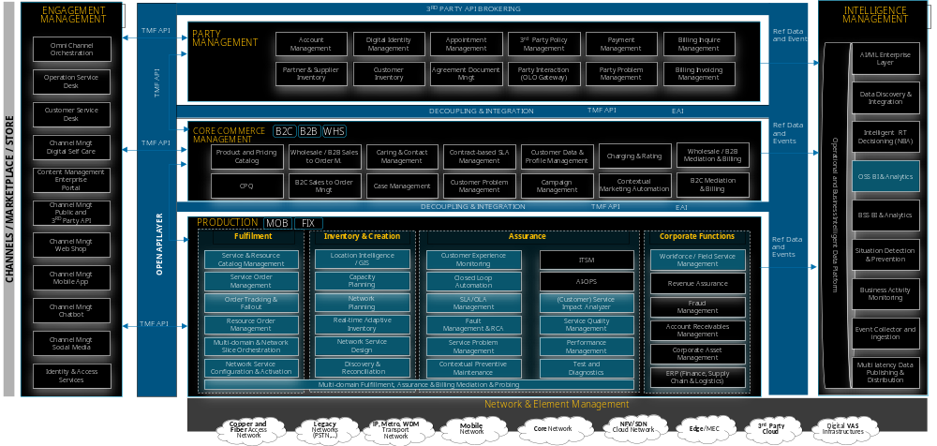

STREAM 4A | INTEGRATED ENTERPRISE ARCHITECTURE APPROACH
Key topics to be addressed in this context to ensure a successful IT Architecture and transition
SOLUTION PRESENTATION
Decide the Channel (App, Web, Store,..) Strategy and schedule immediate actions
Define and Leverage the primary and enabling role of a common Intermediation Layer able to provide an early “One Platform” experience by also keeping transparently alive the 2 BSS/OSS Stack during the transition
Resolve the primary role between the 2 master CRM stacks
for B2B and B2C
Found the Wholesale BSS Stack starting from Fastweb current
solution
Integrate the Customer within a common Customer Inventory with related Service base
Define an immediate Data Management strategy to ensure a data-driven “glue” between the 2 business and operational stacks even if starting from 2 different roadmap and cloud stacks
Contact Center enablement features of the NewCo Customer Service Operations policies
Collect and classify all Intelligent Automation services and assets (AI / ML etc) that can be used or are already used by the different architectural layers and related domains
Customer Experience coexistence on the 2 Portals or setup the foundation of a “newco” Branded Portal
Decide for a common set of Smart Analytics Technologies to provide both OSS and BSS BI Frameworks
Rationalize a common Product & Offering Catalog view and unique CPQ approach and experience to the customer facing services
Design the Convergent Service & Resource catalog paving the way to the template-drive management of the integrated NewCo’s network
Assess the overall Assurance stack for both B2C and B2B with a strong focus on decommissioning non-mission critical legacy systems and analyze the NewCo role of the main technologies such as
Define a common strategy and a multi-phase / transition plan to provide an enterprise framework for the E2E Service Orchestration management for both B2C and B2B delivery orders, leveraging a “business platform” approach and decommissioning legacy
Assess Fraud Management and Revenue Assurance stacks to accelerate the adoption of a common RA/FM stack
Accelerate the ERP Process Merge and Rationalization for the NewCo Legal
Entity founded on
Design a “Federated” layer among the 2 N&S inventories to uniform their model and provide a common end-to-end view on the entire network for management purposes
Thanks to Capgemini Engineering Global Business Lines SMEs, key components of the proposed organization model, we will have a clear view on the current Vodafone and Fastweb network strategy and deployment programs ensuring success in key operations as:
OSS convergence and evolution towards future-proof model (SDN-oriented, based on Domain Controllers & Orchestrators)
5G SA Core Network convergence (harmonizing parallel solutions in a single model)
Harmonization of complementary & innovative technologies (e.g. FWA)
Focus on a common approach to Identity Management
12
Capgemini 2024. All rights reserved |

Slide 13




SOLUTION PRESENTATION
STREAM 4B | FOCUS ON CSS INTEGRATIONS
WE HAVE ANALIZED 3 M&A APPROACHES, FINDING VALUE ACCORDING TO THE KEY TAKEAWAYS
DIVESTURE APPROACH
DEPLOYMENT PHASES
KEY TAKEAWAYS
1
1
NEW
IMPLEMENTATION
VODAFONE
interim
NEWCO
  Modernization of the Application Portfolio
  Alignment to Industry and Product Best Practices
  Adaptation of Processes to the Organization
  Effort of implementation on Business and IT
  Delay on Operational Readiness
  Challenge of redesigning Processes
FI – HR – SC
  It is the process of redesigning and implementing new business processes on a new and common landscape and infrastructure, allowing the incorporation of best practices and specific needs of both the former companies (xFastweb and xVodafone)
FASTWEB
FI – HR – SC
FI
HR
SC
Design
Adopt
2
2
AGGREGATION LAYER
VODAFONE
interim
NEWCO
  Reliability on a Reference Model
  Continuity with Finance Modus Operandi
  Checkpoints to validate the End-state
  Coordination between Mapping logics
  Redundancy or Lack of Companies’ Specific Logics
  Incompleteness of Transformation steps
FI – HR – SC
FI
AGGREGATION LAYER
HR
  It involves keeping current systems and processes as Users layers: Vodafone will start with a divesture project from current landscape, and both will feed a central (finance) system, offering a flexible middle-ground approach between new-implementation and migration
Copy
SC
FASTWEB
VODAFONE
FASTWEB
FI
HR
SC
Map
FI – HR – SC
FI
HR
SC
Keep
Load
3
3
MIGRATION
VODAFONE
interim
NEWCO
  Cost-Efficiency on transferring Data
  Transition to a Target and Controlled Scenario
  Reduction from Business People Availability need
  Dependency on predefined Applications and Solutions
  Complexity on identifying and split out Data
  Adoption of unknown Objects and Processes
FI – HR – SC
FI
HR
SC
  It is the selective extraction and transfer of relevant business data from the original landscape (exV) to a pre-existing one (exF), based on predefined and live business rules, to efficiently “extrapolate” the Divested Company
FASTWEB
FI
exF
HR
exF
SC
exF
FI
HR
SC
Migrate
Adopt
Capgemini 2024. All rights reserved |
13

Slide 14







SOLUTION PRESENTATION
STREAM 4B | FOCUS ON CSS INTEGRATIONS
TO DEFINE THE MOST SUITABLE M&A APPROACH, WE HAVE TO HOLISTICALLY CONSIDER THE MAJOR DIMENSIONS…
A
Application Portfolio
B
Business Involvement
… AND COMBINE THEM WITH ADDITIONAL AND YOUR RELEVANT
SPECIFIC ONES
  Do applications and solutions represent a unique Template for Vodafone and Fastweb?
  If not, what is the degree of Intersection between them?
  What is the expected People Role and their availability?
  Are you looking for a Technical Migration or willing a Business Transformation?
Organizations
Number and skills of
involved Departments
Business Continuity
Business or activity disruption
expected to impact the Program
COMPLETE FIT
MIGRATION
Vodafone and Fastweb App. and solutions are completely aligned in a Core Model Template
Change
Business (and IT) People readiness
to a new working era
A
Application Portfolio
AGGREGATION
LAYER
Knowledge
Processes and Specifications Documents, and Reference People availability
Way of working misalignment due to different Businesses
and / or Siloed Organizations
Landscape
Systems landscape complexity and dependencies
NEW
IMPLEMENTATION
DIVERGENCY
Systems
Technical implications or limitations leading to prioritization (e.g., end of life, upgrades required, licensing, best-of-breed)
LIMITED
CONSISTENT
Organizations People will be involved only to certify no-regressions occur
They will actively join to define a new playing scheme
Time
Program given temporal window and time-dependent constraints
B
Business
Involvement
14
Capgemini 2024. All rights reserved |

Slide 15
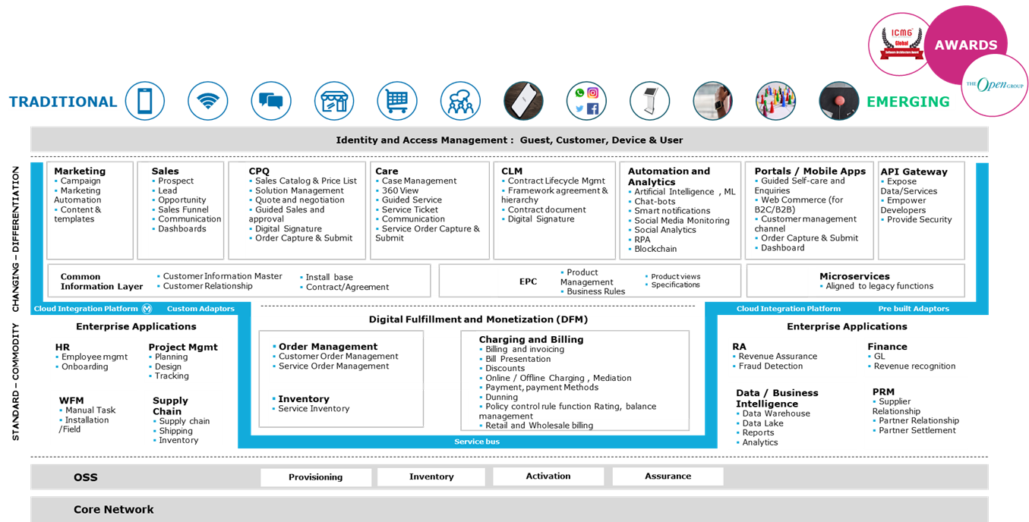
STREAM 4C | FOCUS ON BSS
LEVERAGING OUR AWARD-WINNING TELCO BSS FRAMEWORK FOR DEFINING A TARGET STATE ARCHITECTURE
SOLUTION PRESENTATION
Merger of FastWeb and Vodafone provides an opportunity to radically simplify & enhance customer experience but also enable Business agility needed for future growth.
Key BSS Decisions to be made
How to approach customer migration?
  Is it possible to migrate a customer transparently?
  New customer on new stack, with specific offer?
  Customer invited to migrate via change-order?
  How long a grace period before forced migration?
How should we rank merging of BSS for individual LOBs?
Should individual LOB of NewCo have separate IT stack?
Should we build completely new stack or leverage existing investments?
How do I prioritize / de-prioritize existing transformation programs?
How should we decide which applications (CRM, EPC, COM) should we retain?
What should the engagement layer strategy be for each LOB
Should I build new or modify existing?
There are multiple CRM applications eg. Legacy, Salesforce, Amdocs and Oracle. Which one should I retain?
Should I have separate CRM for individual LOB of merged entity?
Which product catalogue should I retain?
Should I have unified product catalog across the LOB of merged entity?
How should I define my CPQ strategy?
Which Billing applications should I retain from vendors such as Oracle, Huawei, Netcracker, Amdocs?
How do I decide which product catalogs should I retain?
How do I manage existing customers / services while transitioning to newco way of working?
Sample Architecture Principles supporting decisions (simplified)
ODA aligned
Real Time Insight Driven
Digital First
Gen-AI Powered
Catalog Driven
Cloud Native
API Led
Truly Convergent
Modular Design
Common Information View
Multilayering High Decoupling
Agile@scale
Omni-channel
Security & Privacy by Design
Industrialization
Dynamic Case Orchestration
Capgemini 2024. All rights reserved |
15

Slide 16
STREAM 4D | KEY QUESTIONS TO BE ADDRESSED FOR OSS APPLICATION AND DATA
SOLUTION PRESENTATION
What is the best approach to deliver a future proof and reliable OSS architecture?
How to integrate applications and services to enable a great experience?
How to define a plan to deliver the integration and achieve synergy and ensure business continuity?
How to manage, federate or merge different network inventories
  Data driven approach will enable automation that will drive efficiency
  Service Catalogue and Inventory manages the relationships Customer Facing Service (CFS) and Resource Facing Service (RFS) and their relationships and is key to enabling Service Order Management and “Automated Flow Through Provisioning” of Services.
  A focus, during the discovery phase, should be on understanding the catalogue and to what extend it drives automated provisioning.
  The southbound integration should support Resource inventory with Discovery & Reconciliation capabilities.
  Target inventory should store cross domain topology and dependencies, providing E2E visibility of the entire network to ease root cause analysis and service upgrade, a classic issue for many telcos.
  The target solution should provide cross service views and correlation.
  Interoperability in the target BSS/OSS ecosystem should leverage on the standard ODA API framework.
  A catalogue (data) driven approach is essential to deliver agility and reduce TTM for new products and services
  A phased and business driven approach should be adopted to migrate towards open and standard TMF API.
  Transitional Architecture should encapsulate as-is integrations into a decoupling intermediation layer.
  The target architecture should take advantage of the benefits, in term of scalability, reliability and maintainability, coming from a hybrid-cloud and service-oriented Enterprise Architecture with clear function separation guided by TM Forum Open Digital Architecture principles.
  Adoption of a TMF SID Compliant Data Architecture.
  A big bang approach should be avoided, we will adopt an evolutionary approach enabling it’s needed to adopt instead a phased plan with clear disentanglement between technologies and layers.
  Strong focus on decommissioning non-mission critical legacy systems and analyze the NewCo role of the main technologies such as.
  Design of a Federated layer among the 2 N&S Inventories to uniform their data model during transition phase.
  Leverage Discovery & Reconciliation features to improve data consistency and reliability before and after the data migration.
  Phased migration of Design processes (with consequent data mastership shift).
  Phased migration of Operations processes & wizards (e.g.: bulk Creation / Modif. / Decommissioning /Swap for the in-scope service types into CSI).
Capgemini 2024. All rights reserved |
16

Slide 17
Stream 5 | Data & AI
Supporting the transition through an «intelligent data Office» model enabling a «data driven» and «AI infused» IT landscape integration
SOLUTION PRESENTATION
Immediate benefits starting the Transition
Capgemini assets for a Modern Data Office
Putting appropriately valorized and certified "enterprise data" increasingly "at the center" of core processes, creating a transition information “glue” between the 2 IT stacks to grant business continuity while rationalizations and enhancement are happening and to valorize the heritage of the two companies.
  «AI Infused» & «CLOUD enabled» Modern Data Platform
  Smart & Collaborative Data Governance & Data Virtualization Frameworks
  Customer and Network Data Analytics « transition layer » to enable cross-domain visibility under a NewCo approach
  Enterprise Data Hub to feed «RT mission critical business decisioning & NBA central brain»
  IDEA: Our modular and KPI based acceleration framework
  Telco AI/MLOps Factory founded on Telco specific assets and skills of Capgemini Engineering
  GenAI Use Cases @Catalog for Telcos
How we can help
Analyze how to rationalize enterprise-wide data starting from the customer data and the financial data
Leverage Data Virtualization technologies (part of our Modern Data Platform portfolio) to decouple data fruition from current stacks organization
Modernize legacy DWHs towards "cloud native" and "actionable" Data Analytics Platforms enhancing data availability and quality
Evolve a combined Data Platform + corporate Data Governance model in line with the Business needs and eventually changing organization model
Push on AI/Gen AI adoption to move from “data” to “information” and to streamline operational processes
Organize a "Data Lab" model based on an integrated community of IT, Network and Business Engineering lines from both Fastweb and Vodafone teams
WE HAVE A CONSOLIDATE PORTFOLIO OF READY TO GO ASSETS, BEST PRACTICES AND LESSONS LEARNED
1
2
Data Quality Stream
Data Office Enhancement
A “Data Governance” strategy is the first step of the Data Integration journey
A
DATA COMPLETENESS
A
DATA GOVERNANCE FOUNDATION
B
DATA VERACITY
B
DATA GOVERNANCE TOOLS & PROCESS DESIGN
C
DATA DOCUMENTATION
C
DATA OFFICE ROADMAP
D
DATA QUALITY MONITORING

Slide 18
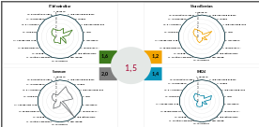
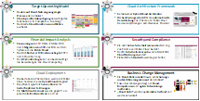
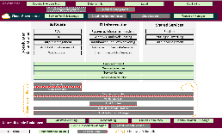
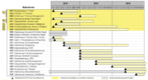
STREAM 6A | CLOUD, INFRASTRUCTURE & CYBER SECURITY
We will use our Cloud Strategy Framework to develop the Infrastructure Strategy and Migration Plan
SOLUTION PRESENTATION
0
1
2
3
Transparency Assessment
High-level design
Medium-level design
Transformation Roadmap
Cloud Migration
Kick-off
Assessment of existing Cloud/ digital capabilities
Prerequisites for Cloud implementation
Setup of project structure and identification of stakeholders
Definition of strategic guidelines
Quick-Check based on existing information
First alignment on target picture
High-level evaluation of different design options
Description of proposed Digital Platform
Use of proven methodology / framework for Cloud strategy development (Capgemini Cloud Choice)
Consideration of best practice insights and project examples from previous engagements
More detailed description of Digital Platform
Cloud service brokerage design
Analysis of business implications/benefits
Outlining of financial implications
Derivation of skill / capability requirements
Analysis of security implications
Creation of comprehensive Cloud transformation & Infrastructure roadmap
Description of required decisions and implementation actions
Fine-tuning of deliverables
Creation of Target Picture
Finalization of executive presentation / decision document
Activities
Maturity assessment
Validated prerequisites for Cloud implementation
Transparency in all focus areas
Cloud platform high-level design / architecture
Aligned target picture
High-level financial and organizational implications
Target Operating Model incl. skills and roles
Detailed financial implications
Cloud Security Strategy
Implementation proposal
Comprehensive roadmap for prioritized measures
Outputs
Capgemini 2024. All rights reserved |
18

Slide 19
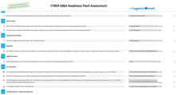
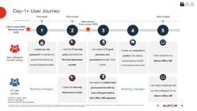

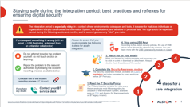


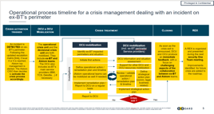
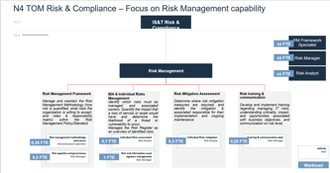
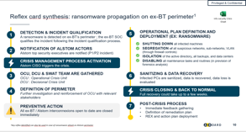
STREAM 6B | CLOUD, INFRASTRUCTURE & CYBER SECURITY
Cybersecurity is a major risk during the integration – A specific focus is recommended TO SECURE DAY 1 AND prepare integration execution is necessary
SOLUTION PRESENTATION
Challenges
Why Cybersecurity is Key in your context
Assess the Situation
Limit the risks
Building the future
Discover the functioning of the company to be integrated
Identify risks and vulnerabilities
Identify critical assets
Define the cybersecurity levels to be reached before integration
Identify and secure critical actions before/after Day 1
Define the target cyber security operating model principles for the integration
Unite the two companies, communicate effectively and manage change
Cybersecurity threats are increasing in M&A Contexts (public exposure)
Cross-companies collaboration is increasing the attack surface
Authorities recently raised Cybersecurity threat threshold
Examples of our Cyber M&A Assets
Cybersecurity Flash Assessment
Sensibilization Day-1
What needs to be done before Day-1
Assess Cybersecurity posture and risks separately for Fastweb and Vodafone Italy
Strengthen Cybersecurity protection and detection capabilities for both
Define joint intermediate procedures to exchange information, respond and recover in case of Cyber attack
Cyber Crisis Preparation
Operating Models
Capgemini 2024. All rights reserved |

Slide 20

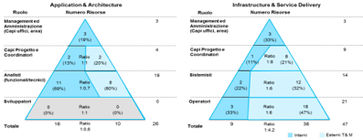
SOLUTION PRESENTATION
STREAM 7 | SOURCING & CONTRACT MANAGEMENT
From two different models …
… towards a unified model with:
Contracts and Term & Conditions
The analysis will allow to evaluate:
savings from negoziation where economy of scale are present
improvement on T&C where the same vendor offer the same services on both companies
best rates where the same vendor offer the same services on both companies
Expected savings due to economies of scale
Best Rates and Term & Conditions where the same vendor offer the same services on both companies
Alignement on KPIs and SLAs
IT Suppliers and Competencies
The analisys will allow to evaluate:
rate of fragmentation of supplier
risk toward vendors / counterpart
level of dependencies towards a supplier and the balance between internal and external competencies
A vendor consolidation plan that guarantee the expected savings
The right balance/mix between risks, competencies and independency from supplier
Weak internal competencies
Strong internal competencies
Suppliers dependant
Suppliers indipendent
Balance internal / external resources
The analisys will allow to evaluate:
the ratio between internal and external resources for each domain
the ratio between internal and external resources for each type of work (project manager, developers, …)
The right ratio between internal and external resources aligned with the overall strategy of the company
Capgemini 2024. All rights reserved |
20
Notes:
20

